Slide 1
Final Project DATA 607
Does oral and dental hygiene plays a role in glaucoma?
Hui Han, Jun Pan

Slide 2
Motivation
Dr. Casella reported that oral and dental hygiene plays an important role in glaucoma based on 119 cases in his clinic(January 2017, OptemeryTimes.com).
He suggested that the elevated presence of certain bacterial species in the oral cavity can serve as a catalyst for a pro-inflammatory response on the part of the immune system, which will lead to glaucoma.
We try to further investigate the correlation on a much larger scale database.
Data Source: Korea National Health and Nutrition Examination Survey (KNHANES http://knhanes.cdc.go.kr) has a total of 13,831 participants with age 40 or above. This survey uses a complex, stratified, multistage, probability-cluster survey.
The data based which we are going to use are the following years (2008,2009, 2010, and 2011).

Slide 3

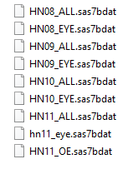

Import Database of KNHANES
Download database from Website in SAS files
Read SAS files
Write into CSV
Survey files include the dental information
Eye files include the glaucoma information

Slide 4

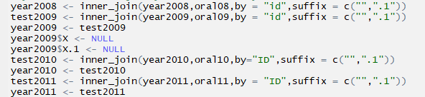
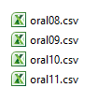
Write into CSV files

Slide 5
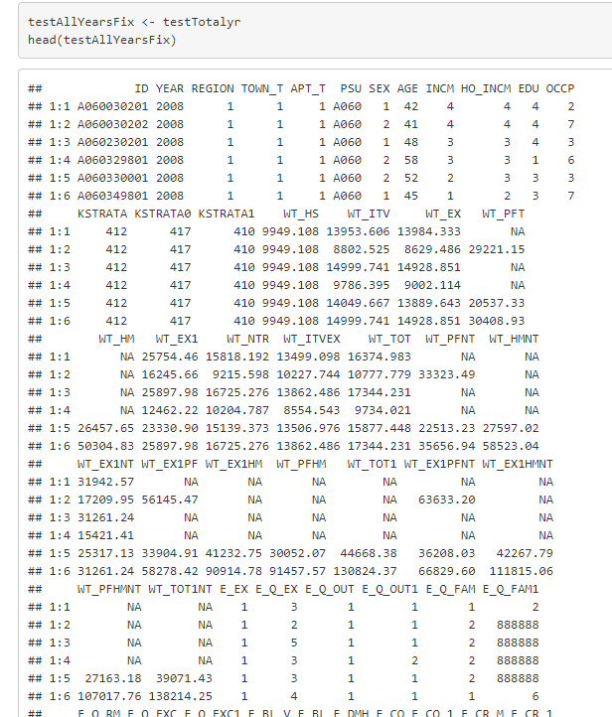
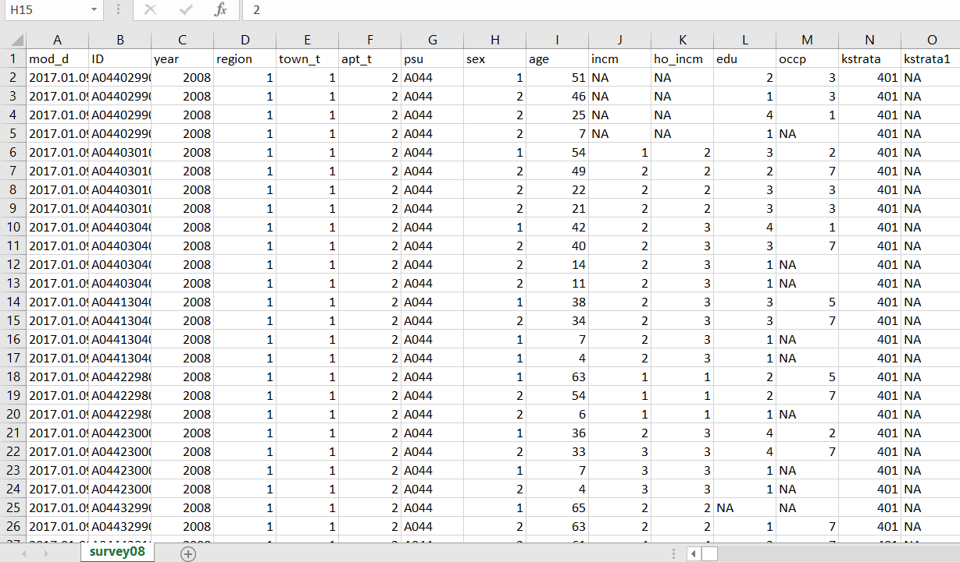

Slide 6
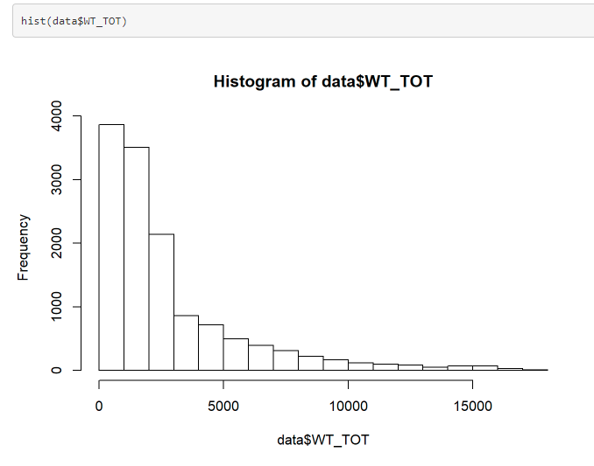
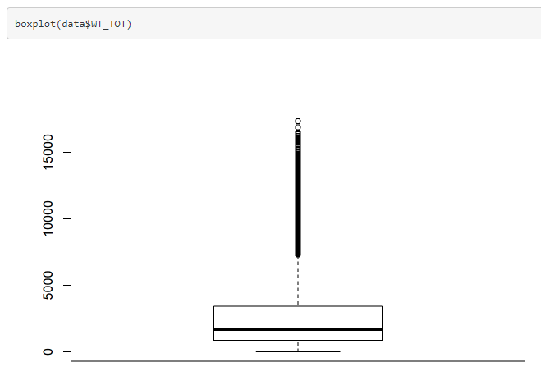
KNHANES assign a weight to each participant

Slide 7
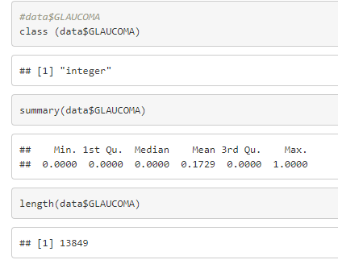
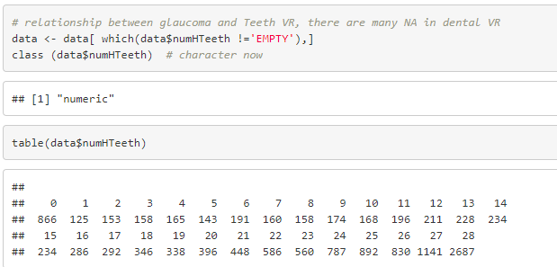

Slide 8
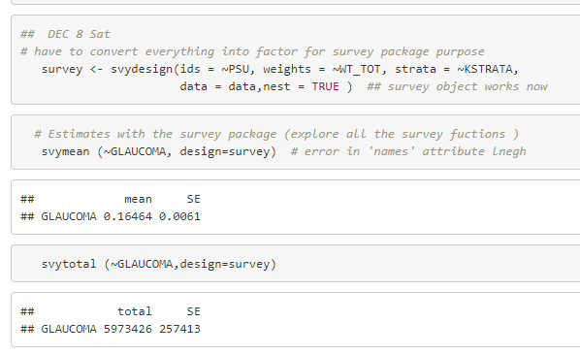
Analysis of Data using the “survey” package
The survey package provides a survey.design object, which is a container for a dataset and the sampling design information, including sampling scheme, weights, population sizes (and more).
The svydesign function is used to create survey.design objects. It has a number of arguments, but the most important for you are:
ids: Name of variable in the dataframe that contains cluster ids
strata: Names of stratification variables, as a formula: ~var1 + var2 + var3
fpc: A vector the same length as the data, giving the stratum population size for each observation. The name is confusing, since you don’t actually supply the finite population correction factor.
data: Dataframe containing the raw survey data

Slide 9
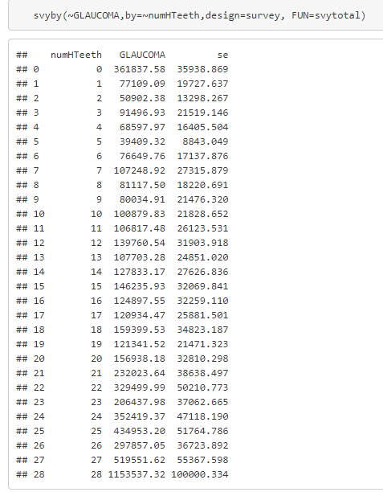

Slide 10
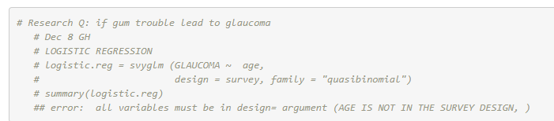
Logistic Regression

